Slide 1
Pizza analytics 101
Exploring the Data Tale of Dave Portnoy’s Pizza Adventures
Presented by: Armin Hatami
Last Updated: December 6th, 2023

Slide 2
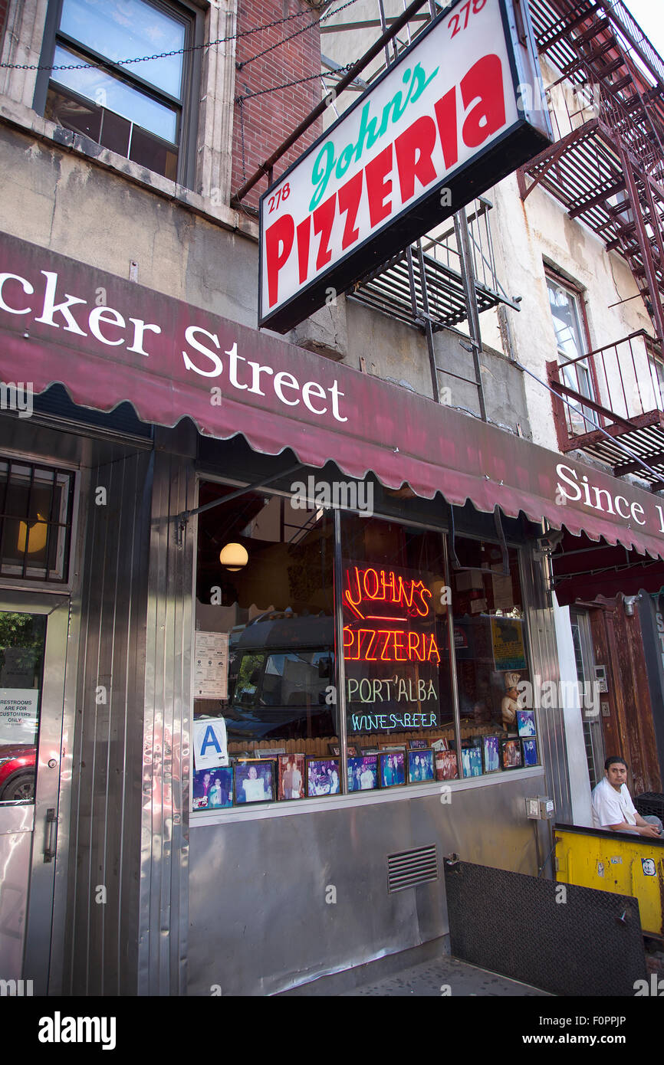
Motivation

Slide 3
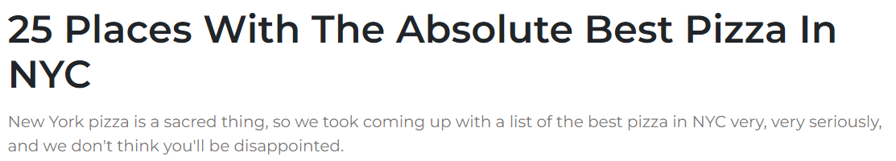
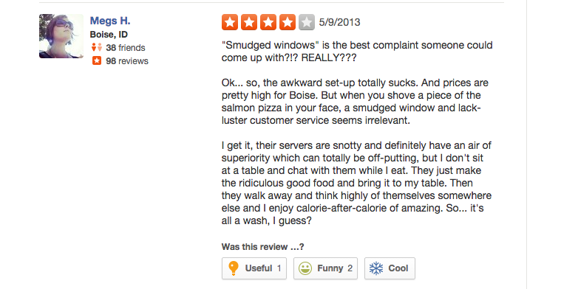
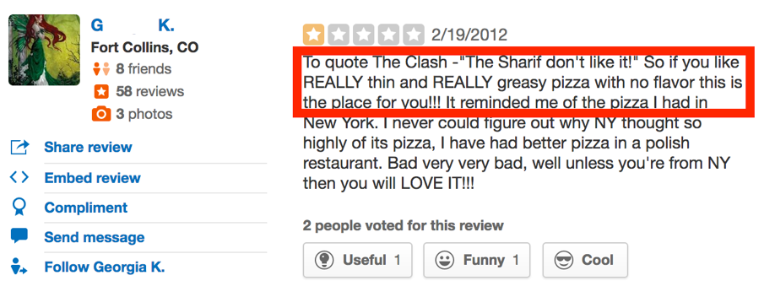
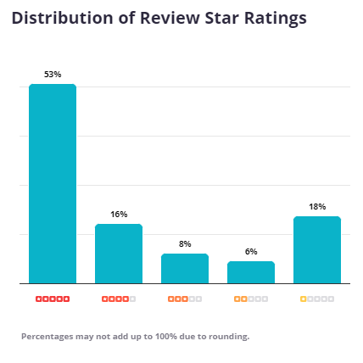
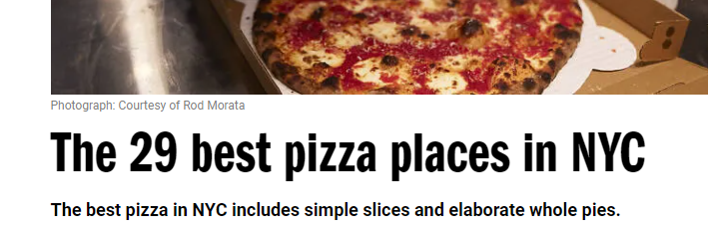
The Search for the Dataset
Notes:
Dilemma in evaluating pizza quality:
- Challenges with existing review platforms: Filtered and people usually only rate on bad/great experiences
- No standardized ratings
- The Ideal Scenario: Randomized Reviews with a scale granular enough to get a probability density

Slide 4
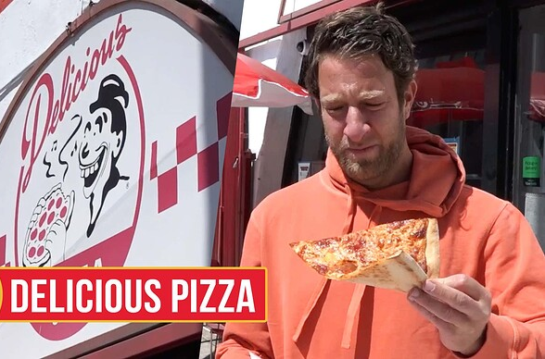


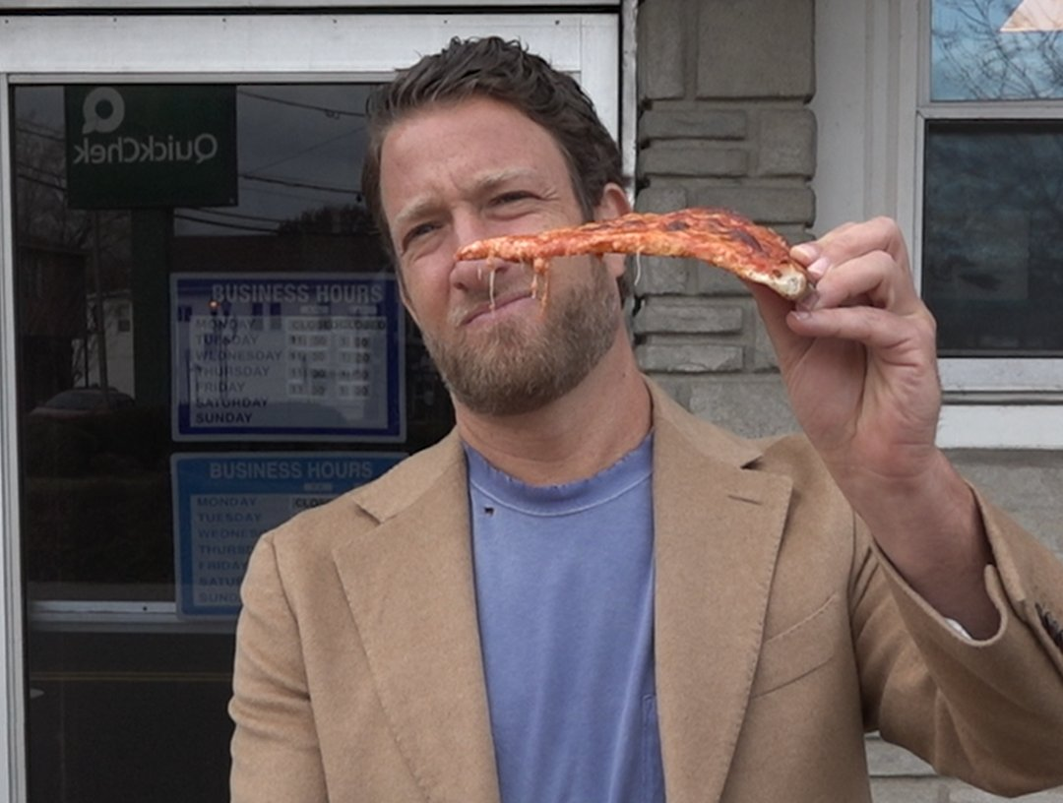
Discovering Dave
0 to 10 scoring system
No round numbers
Detailed breakdown:
Below 3.0 - inedible
3.1 to 5.0 - below “average”
5.1 to 7.0 - football pizza
7.1 to 8.0 - good to very good
8.1 to 9.0 - excellent
9.1 to 10.0 - nearly perfect

Slide 5





Data Extraction
Web Scraping vs. Ethical Concerns
Unveiling the One Bite API
https://one-bite-api.barstoolsports.com

Slide 6
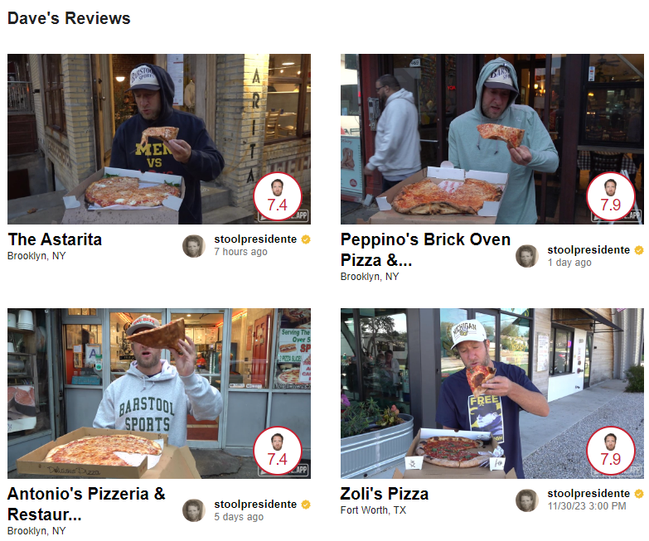
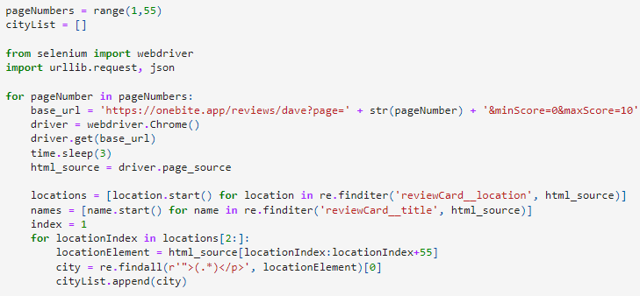
Data Extraction (cont’d)
Location-based API
Several ways to search for ratings
Grid search
Random search
Proportional-sample random search

Slide 7
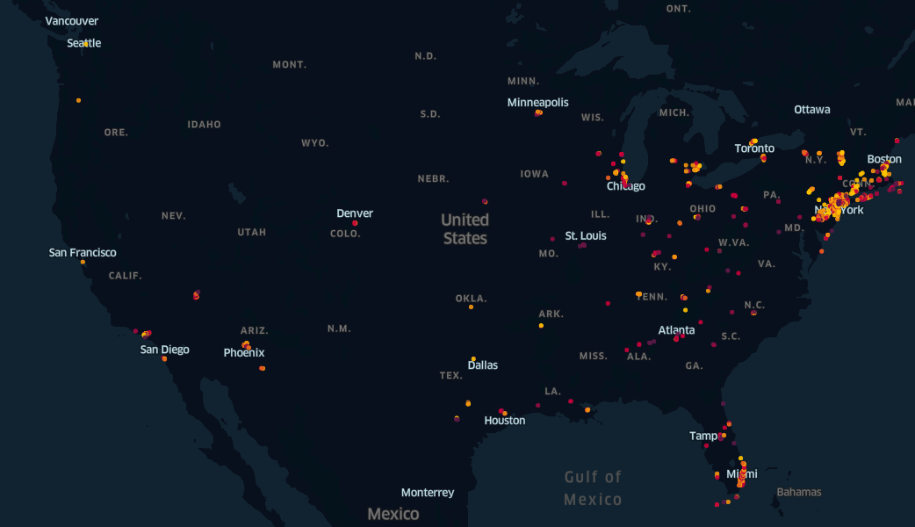
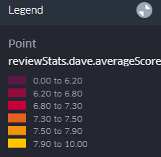

Slide 8
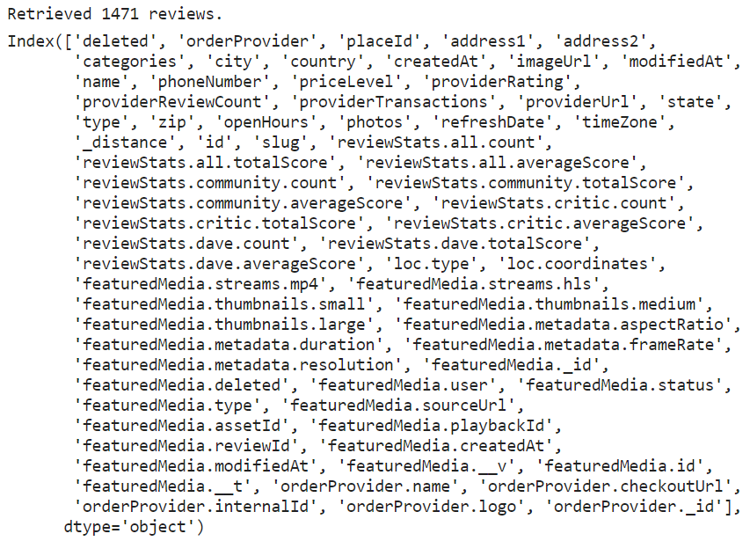
Data processing
Lots of useful information
Review scores, community feedback, and more
Missing coordinates
Geocoded using address
Median score: 7.3
Standard deviation: 1.4

Slide 9
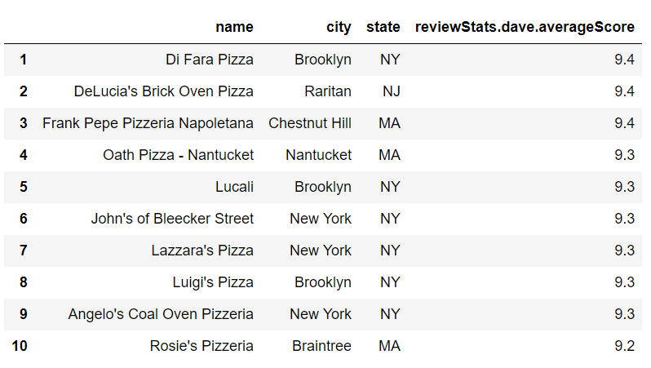
Top 10 Pizza Shops

Slide 10
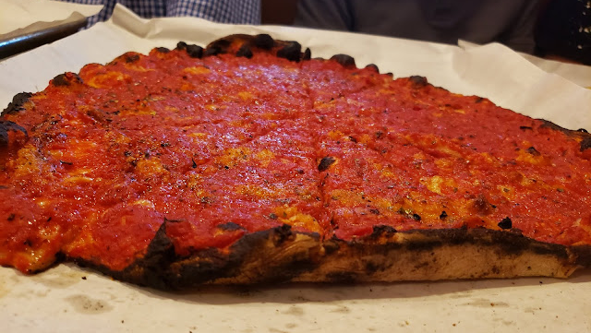
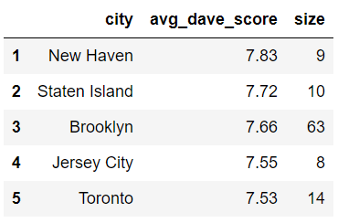
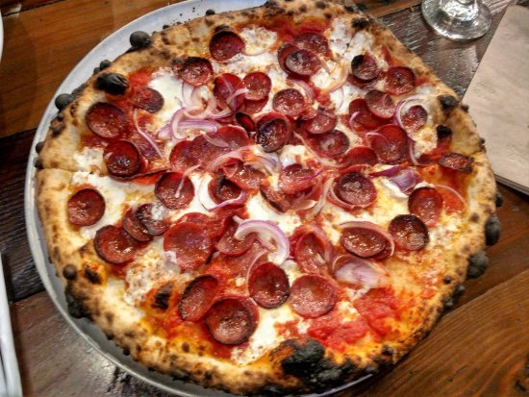
Pizza Capital of the World

Slide 11
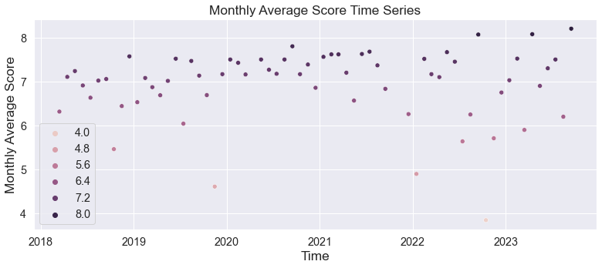
Monthly Averages

Slide 12
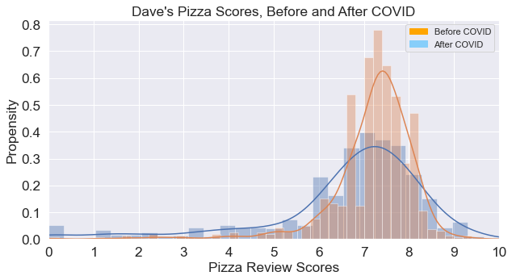
Scores Before and After March 15th, 2020

Slide 13
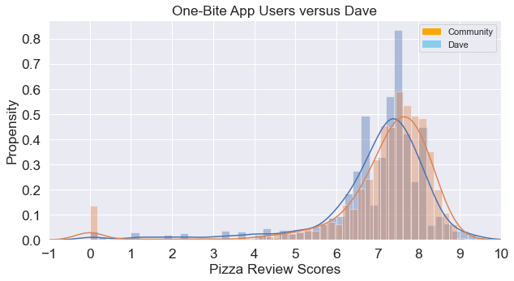
The Community versus Dave

Slide 14
Future Adventures in Pizza Data
Finding the shortest path between the pizza clusters
How is rating affected when Dave sees the user reviews beforehand?
Dave’s ratings on weekdays vs. ratings on weekends
Do cash-only shops rank higher than shops that accept all forms of payment?
Do shops with shorter openHours rank higher than shops with longer openHours?

Slide 15
Conclusion
Questions and Further Exploration

